Slide 1


HEP Weekly Report
George Bakas
NTUA

Slide 2
Progress Report
DCS
dbEditorAndNavigator in fwInstallationUtils component
Bug fixes
New features
fwInstallUtils ConfDbChecks
System checks for all types of addresses
With some help, now its faster
Redundancy task
Managed to create 2 redundant projects on different systems
FSM not stopping when switching from active to passive peer

Slide 3
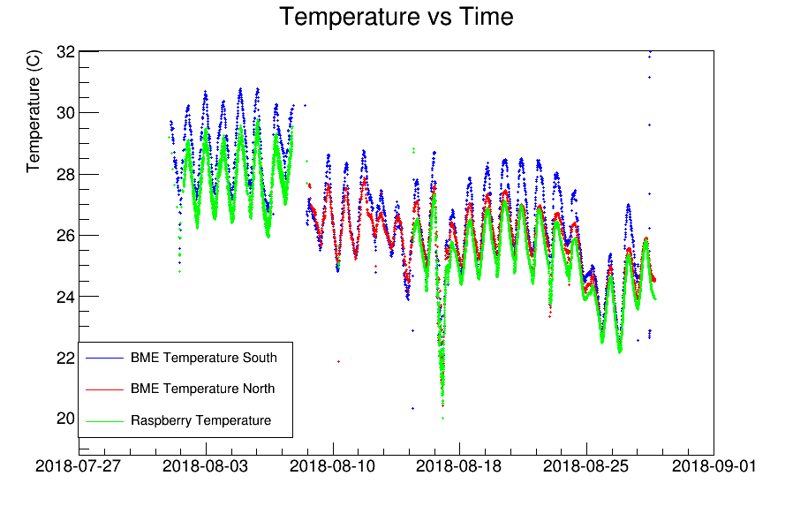
ArdEnvino
2 sensors were running for almost a month for the August test beam for RD51
1 more sensor was running on Raspberry

Slide 4
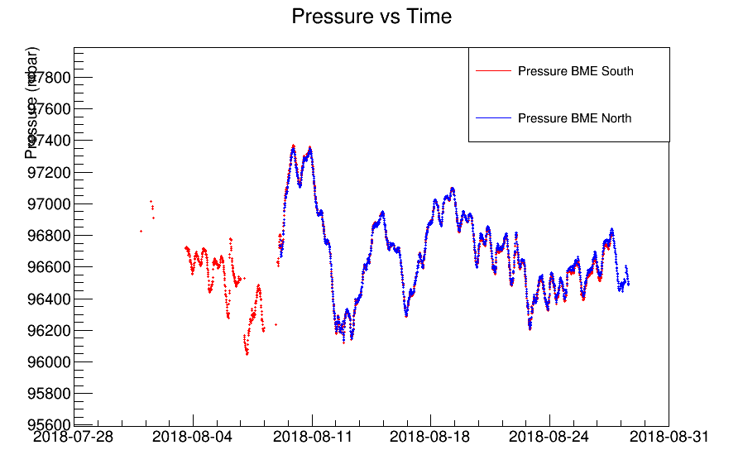

Slide 5
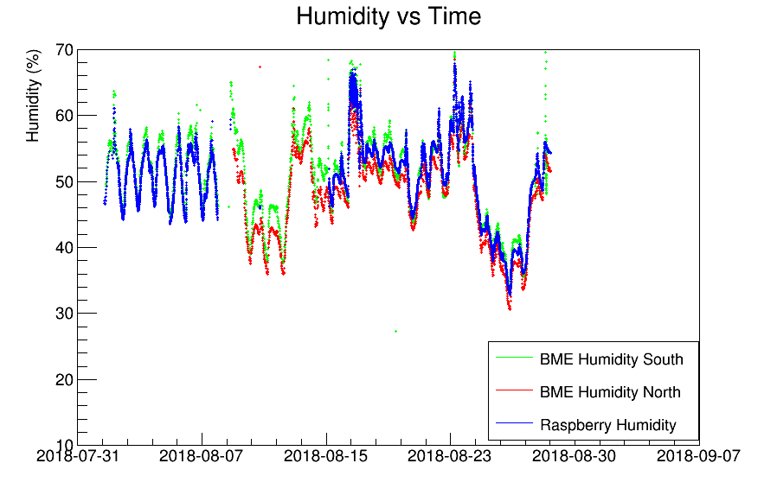

Slide 6
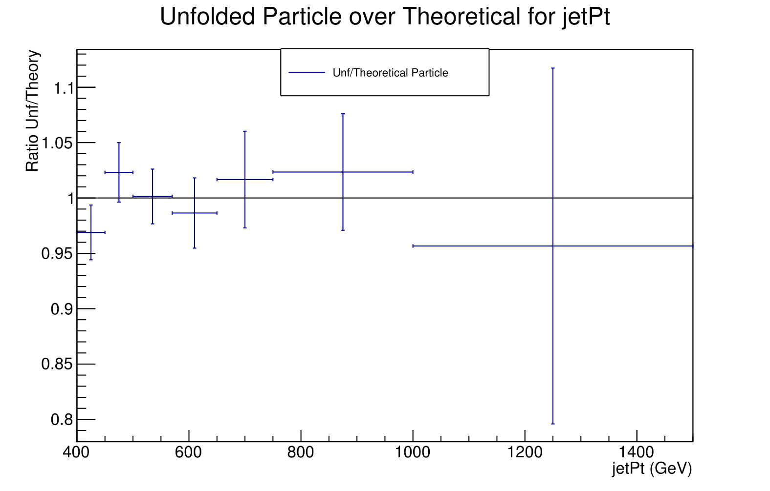
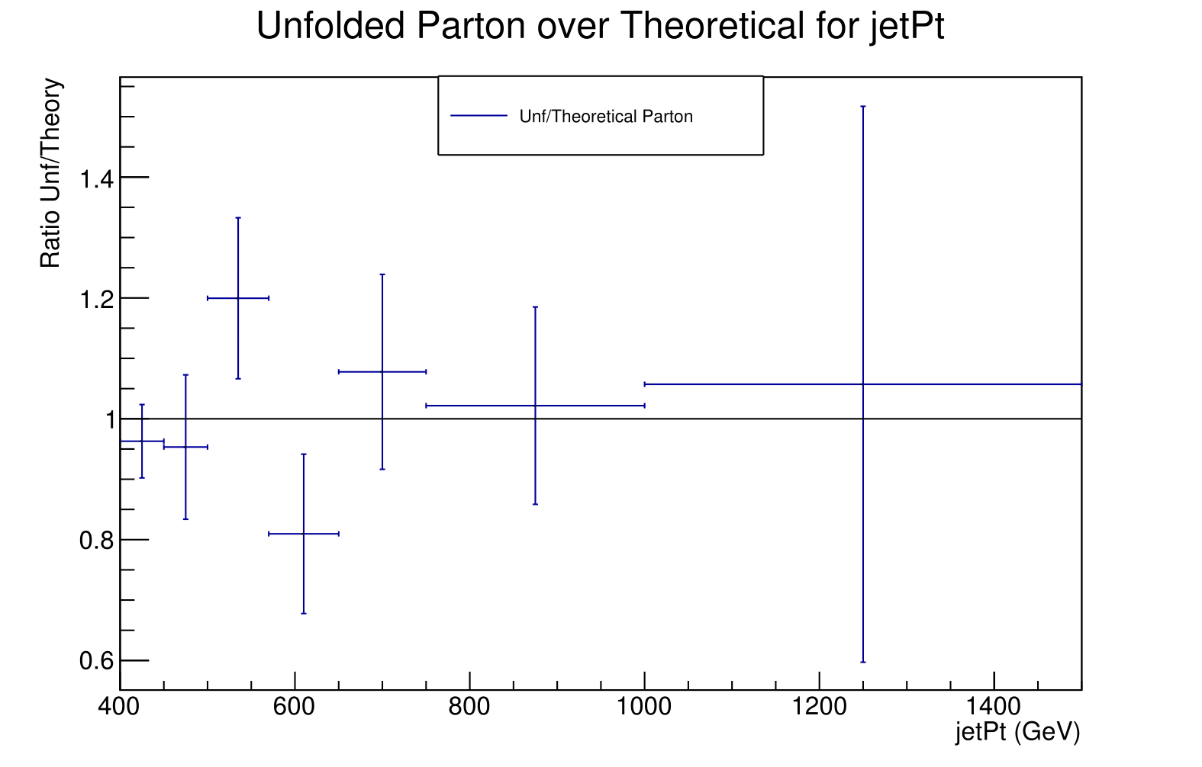
Analysis
Help with closure Tests
Unfolding on MC so that we see perfect closure with simple response matrix inversion (also errors before and after unfolding)
Started looking on how to make productions…
Unfolding closure test with half of the nominal MC sample:
As input→ parton or particle events gotten from 1st half of the sample
As response matrix → filled from parton/particle and reco events from 2nd sample
Unfolding procedure and then the unfolding output is compared with the reco data from 1st sample

Slide 7
HGCAL PLC
Progress on the CMSfwPlc new component that we are working on with Giannis
User will now have to make an XML to load any PLC configuration
All of the types are configured at once (sensors, relays, groups) etc
Completely independent from CMS_TRACKER components
Panels for PLC monitoring are there
Monitoring of the PLC’s of the Tracker Test beam

